Slide 1

Case
Study
GitHub

Slide 2
“NOT FAST JUST FURIOUS”
Team
ANSHUL SHIVHARE
RANVIJAY TANWAR
MRUNANK BHOSALE

Slide 3
About Github
It was founded by
Tom Preston-Werner,
Chris Wanstrath, P. J. Hyett,
Scott Chacon in 2008.
GitHub was originally known as Logical Awesome LLC.
The trademark mascot of GitHub is called Octocat.
GitHub is a global company that provides hosting for software development, version control using Git.
Git is a distributed version-control system for tracking changes in source code during software development.

Slide 4
GitHub Services
Projects on GitHub can be
accessed and manipulated using the standard
Git command-line interface and all of the
standard Git commands work with it.
GitHub also allows registered and
unregistered users to browse public repositories on the site.
The site provides social networking-like functions such as feeds, followers, wikis (using wiki software called Gollum) and a social network graph to display how developers work on their versions ("forks") of a repository and what fork (and branch within that fork) is newest.
GitHub Enterprise
GitHub Enterprise is a self-managed version of GitHub with similar functionality. It can be run on an organization's own hardware or on a cloud provider, and it has been available since November 2011.

Slide 5
To enter the GITHUB
GitHub Services
URL : www.github.com

Slide 6
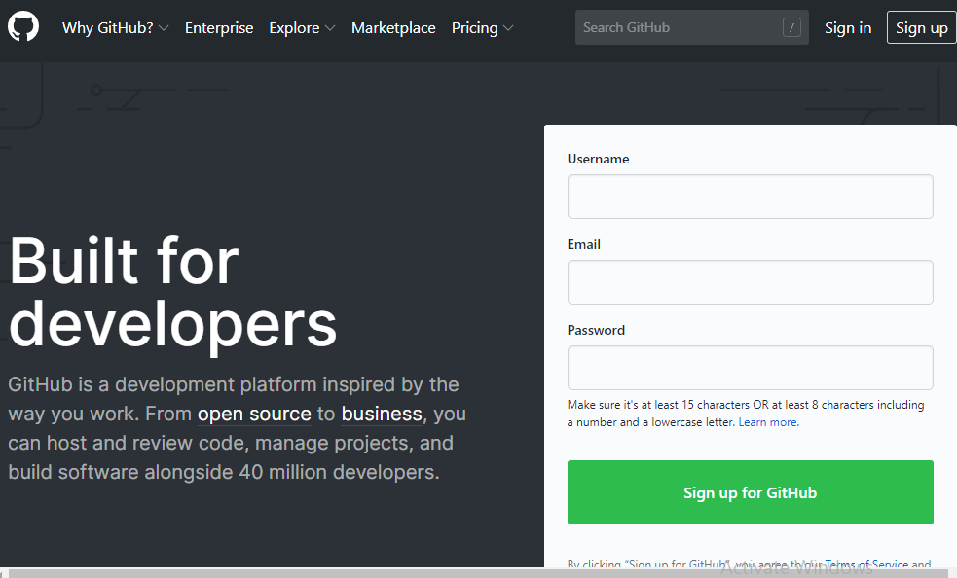
Github Home
Login
Register
User can also explore existing projects.

Slide 7
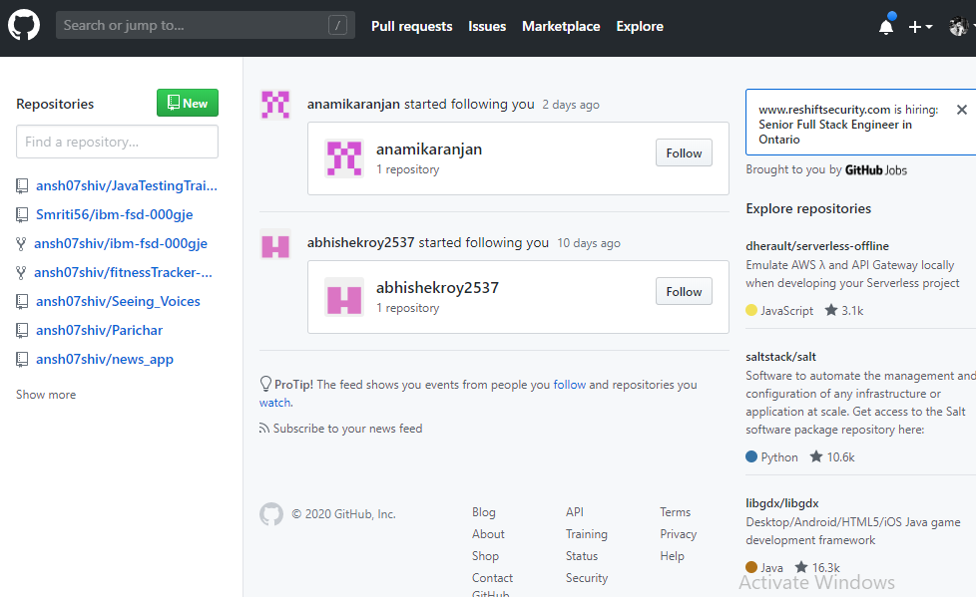
User Home

Slide 8
Creating a
Repository
Repository is like a new
Project Folder which will be public
To every User.

Slide 9
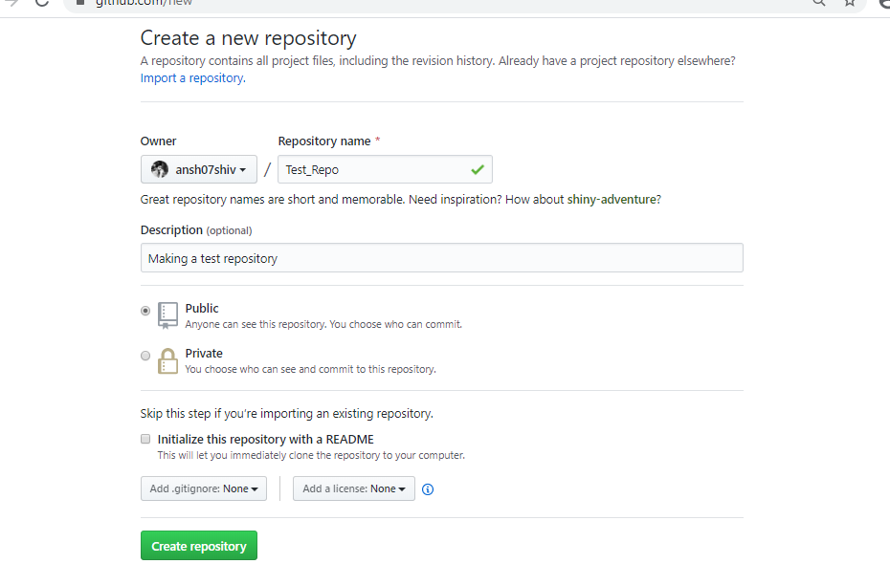
Public Repository
Any User can request Pull
Or Push into the
repository.

Slide 10
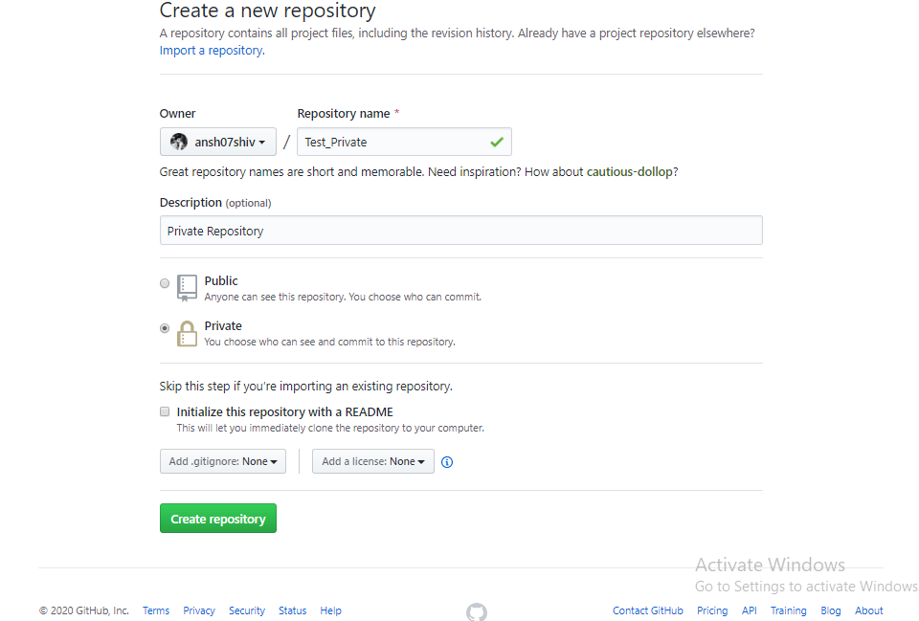
Private Repository
Only authorized users
can request Pull
Or Push into the
repository.

Slide 11
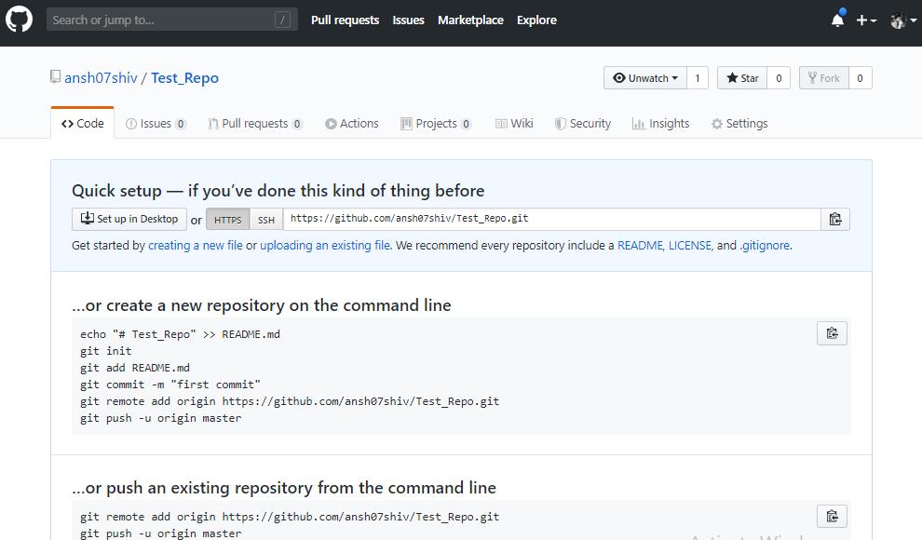
Repository Home
Can use link to upload
Code OR drag and
Drop files.
File Limit < 25MB

Slide 12
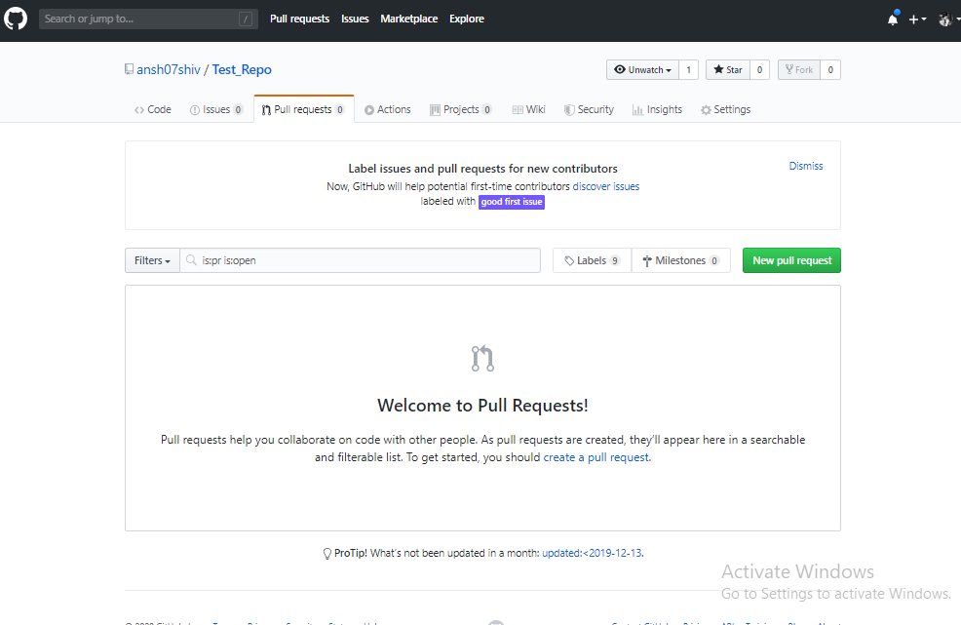
Pull Requests
User can check Pull
Requests from other
Users here.

Slide 13
Few Commands
For using GitHub
Through Console
Git clone “url” : To Download the code from Repository
Git add . : Adding files to the cache
Git commit –m “Msg” : A msg associated with the upload.
Git push : Uploading Code to repository.

Slide 14
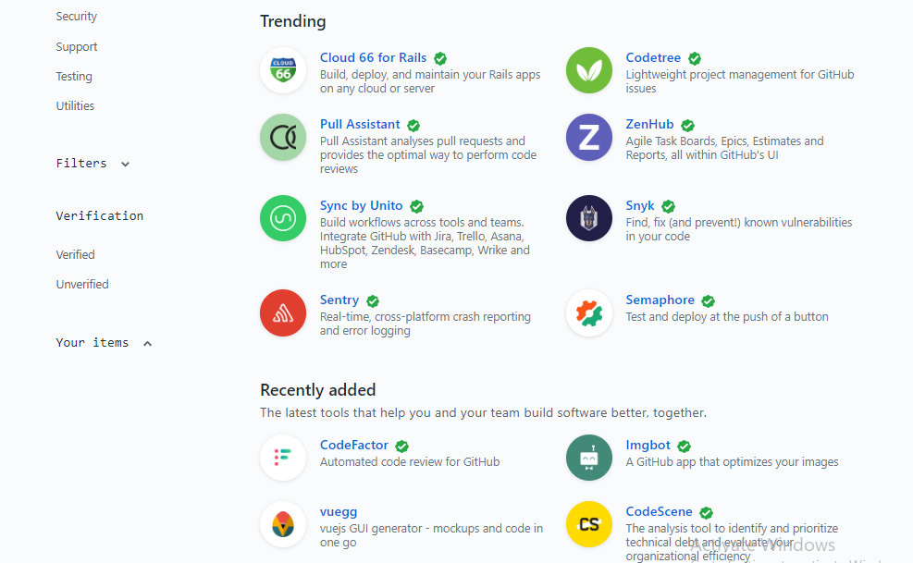
Marketplace for
Enthusiasts
Explore available
Repositories for
Latest frameworks
And other open source
Projects.

Slide 15
Thank
You

